Slide 1
Sentiment Analysis Web Application
A mini project using Flask and Machine Learning

Slide 2
Introduction
What is Sentiment Analysis?
Sentiment analysis involves determining the emotional tone behind a series of words. It is used to analyze opinions, sentiments, emotions, and attitudes from text data.
Why Sentiment Analysis Matters?
It helps businesses understand customer feedback and improve customer experiences.
It's widely used in industries like marketing, politics, and social media for sentiment detection, review analysis, and brand monitoring.

Slide 3
Problem Statement
With the increasing amount of text data from sources like social media and reviews, manually analyzing sentiment is time-consuming and inefficient. There is a need for an automated system that can quickly and accurately determine whether a piece of text expresses a positive or negative sentiment.
Solution
This project proposes a web-based application that uses machine learning to automatically classify the sentiment of a given sentence as positive or negative. Users can input a sentence, and the system will predict the sentiment in real time, providing quick, scalable, and accurate sentiment analysis.

Slide 4
Project Overview
Objective : To build a web application that analyzes the sentiment (positive/negative) of a sentence using machine learning.
Tools Used : Flask, Logistic Regression (scikit-learn), Pandas, NumPy, re (regular expressions) , TF-IDF, Matplotlib, HTML
Dataset : A set of positive and negative words used for training the sentiment analysis model (.xlsx file).

Slide 5
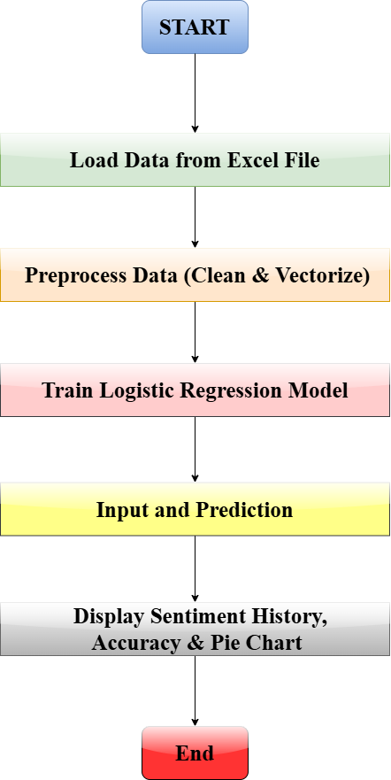
System Architecture
Frontend: Flask serves a web page where users can input a sentence for analysis.
Backend:
Data Preprocessing: Clean and preprocess input text.
Model: Logistic Regression to classify sentiment.
Visualization: Pie chart to show sentiment distribution.

Slide 6
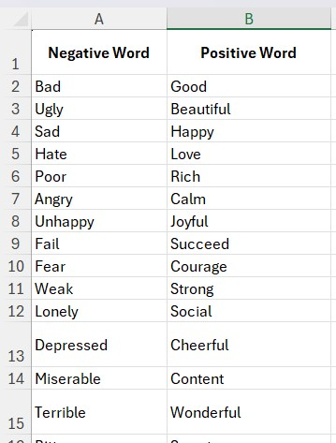
Dataset
The dataset is an Excel file (.xlxs) containing positive and negative words that will be used to perform sentiment analysis.
The dataset contains two key columns:
Positive Word: Words that express a positive sentiment.
Negative Word: Words that express a negative sentiment.
These columns will be used to create sentences, which will then be classified as positive or negative based on the sentiment of the word.

Slide 7
Data Preprocessing
Loading: The dataset is loaded using pandas.read_excel().
Column Cleanup: Unwanted spaces in column names are removed using
.str.strip().
Data Extraction: Positive and negative words are extracted into separate
lists, and any missing values are dropped.
Sentence Creation: Each word is converted into a sentence (for easier
processing).
Labeling: Positive words are labeled as 1 and negative words as 0.

Slide 8
Preprocess the text (lowercase and remove non-alphabetic characters).
text = text.lower
text = re.sub(r"[^a-zA-Z\s]", "", text)
Why it's important: The model doesn't need numbers or special characters, and making
all the text lowercase ensures uniformity
Vectorize the text using TF-IDF to convert text into numerical data.
Machine learning models can only work with numerical data
Label encoding to represent positive and negative sentiments as 1 and 0.
This is essential because machine learning algorithms work with numeric labels.

Slide 9
TF-IDF (Term Frequency - Inverse Document Frequency)
TF-IDF is a numerical representation used in natural language processing (NLP). It is commonly used for text vectorization, transforming text into a format that machine learning models can understand.
Term Frequency (TF): Measures how frequently a term (word) occurs in a document.
Inverse Document Frequency (IDF): Measures how important a term is within the whole corpus of documents.
TF-IDF = TF×IDF
Alternatives - Word2Vec, GloVe, and BERT

Slide 10

Model and Training
Model: Logistic Regression is used for binary classification (positive or negative sentiment).
Training Process: The model is trained on a labeled dataset with preprocessed TF-IDF features, and performance is evaluated using accuracy on a separate test set.
Evaluation Metric: Accuracy is used to assess the model’s performance.

Slide 11
Logistic Regression
It is a supervised machine learning algorithm
Simplicity and Interpretability: Logistic regression is simple to implement and provides easily interpretable results. For a basic sentiment analysis task, it is efficient and effective.
Good Baseline Model: It often serves as a good baseline model before trying more complex algorithms.
Probabilistic Output: Logistic Regression outputs a probability score (between 0 and 1), making it useful for classification tasks with clear decision boundaries.
Alternatives - Decision Trees, Neural Networks, KNN, Naive Bayes

Slide 12
Sentiment Prediction
Users input sentences via a web interface
The model predicts whether the sentiment is Positive or Negative
Prediction results are displayed in real-time
Visualization:
Pie chart displaying the percentage of positive and negative predictions
Uses Matplotlib for dynamic chart generation
Visual representation of sentiment trends based on user inputs

Slide 13
Libraries used and their roles
Flask: For building the web application and handling user input/output.
Pandas: For loading, cleaning, and processing the dataset.
NumPy: For managing arrays used in data processing.
re: For text cleaning and preprocessing (removing unwanted characters).
scikit-learn: For building the sentiment analysis model, including vectorization and training.
Matplotlib: For generating a pie chart to visualize sentiment distribution.
io: For handling in-memory data like the pie chart image.
base64: For embedding the chart image into the HTML page.
FigureCanvasAgg: For rendering Matplotlib figures as images for display in web applications.

Slide 14
Challenges and Future Scope
Challenges:
Data imbalance and inconsistent data.
Context based prediction.
Future Work:
Integrating more complex sentiment labels (neutral, mixed).
Use more diverse datasets for training.
Emotion Detection and Multimodal Sentiment Analysis.

Slide 15
References
Sentiment Analysis
https://www.researchgate.net/publication/332451019_A_Study_of_Sentiment_Analysis_Concepts_Techniques_and_Challenges
II. Logistic_Regression
https://www.researchgate.net/publication/353514662_Sentimental_Analysis_using_Logistic_Regression
III. Text Vectorization
https://www.researchgate.net/publication/388315170_Text_vectorization_in_sentiment_analysis_A_comparative_study_of_TF-IDF_and_Word2Vec_from_Amazon_Fine_Food_Reviews

Slide 16
Thank You!

Slide 17
Team Members
Harsh Tanpure (AIDSU23039)
Arpit Thakur (AIDSU23032)
Shivraj Sagane (AIDSU23059)
Yuvraj Mahale (AIDSU23068)
Yash Gorle (AIDSU23067)
Himanshu Shelke (AIDSU23040)

